Slide 1
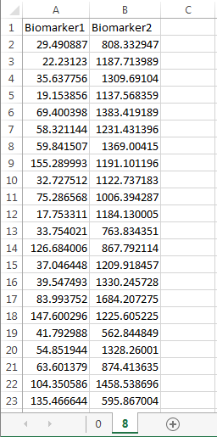
Each column represents one measured biomarker or variable (fluorescence intensity/ gene or protein expression etc.)
Mandatory: The first row has to name column headers to indicate what variable is being measured.
Each row represents one cell. The entries are the cell-specific measurements that can then be used to classify the cell into phenotypic states
For single cell data, Transcompp expects at least 100 rows (cells)
Mandatory: Each sheet name has to be an integer representing the experimental time-point (units are arbitrary (hours/minutes/days)
Each file corresponds to one replicate. When more than one replicate is present, multiple files need to be uploaded

